Slide 1
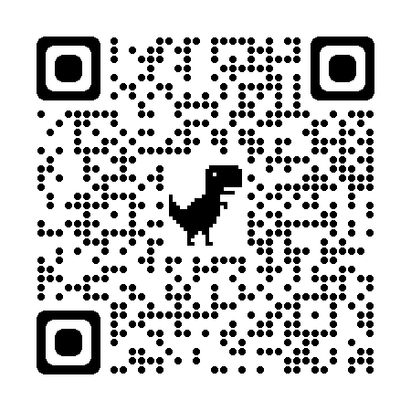
The University of Arizona Campus Arboretum is a living laboratory promoting stewardship and conservation of urban trees through research, education and outreach.
FALL 2024 | GUIDED TREE TOUR SCHEDULE
Tours are offered in the morning and last 60-90 minutes. Please check registration links for specific start times and where to meet. Parking is available in campus garages for $2 per hour.
Day | Date | Tour
Sun. | Sept. 15 | Old Main – New Directions
Sun. | Sept. 22 | Arboretum History
Sat. | Sept. 28 | ENR2
Sun. | Sept. 29 | Sonoran Natives
Sun. | Oct. 6 | Trees Around the World
Sat. | Oct. 12 | ENR2
Sun. | Oct. 13 | Edible Landscapes
Sun | Oct 20 | Medicinal Plants
Sun. | Oct 27 | Arboretum History
Sat. | Nov. 2 | ENR2
Sun. | Nov. 3 | Sonoran Natives
Sun. | Nov 10 | Trees Around the World
Sun. | Nov 17 | Edible Landscapes
Sun. | Nov 24 | Medicinal Plants
Sun | Dec 1 | Old Main – New Directions
Sun | Dec 8 | Arboretum History
Sat | Dec 14 | ENR2
Sun | Dec 15 | Sonoran Natives
Registration for Fall 2024 tours is now open. Please use this link for detailed information and to register: arboretum.arizona.edu/tree_tours
Special tours are offered from November-April and are available by request. To arrange a group tour, please e-mail:
Arboretum-Tours@arizona.edu
Visit the Campus Arboretum Office at: 101 Herring Hall
P.O. Box 210036 Tucson, AZ 85721

